Slide 1
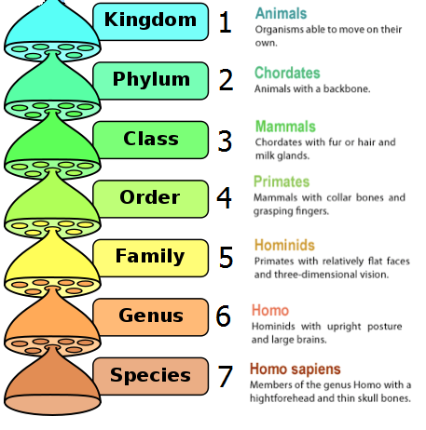
Daily Review
There are seven different levels of classification which are used to organise living things. They can be remembered with a simple phrase:
Kingdom Kings Kids Katie,
Phylum Park Playing Please
Class Can Cricket Come
Order Offer OR On OR Over
Family Families Freeways For
Genus Great Get Great
Species Scenery Squashed Snacks
This is how a human would be classified:

Slide 2
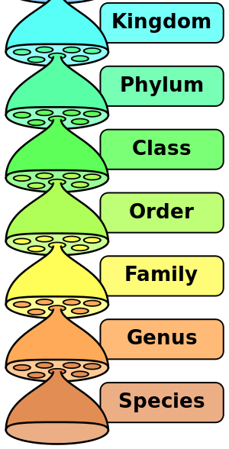
Daily Review
On your whiteboard:
Write one of the sentences that helps you remember the seven levels, like:
Kings (or Kids)
Park (or Playing)
…
Next to each word, write the name of the level
Kingdom
Phylum
…
Notes:
Kingdom Kings Kids Katie,
Phylum Park Playing Please
Class Can Cricket Come
Order Offer OR On Over
Family Families Freeways For
Genus Great Get Great
Species Scenery Squashed Snacks

Slide 3
Kingdoms Year 7 Science

Slide 4
Learning Objectives
CFU
How many kingdoms of living things will we be naming and describing today?
Name and describe three kingdoms of living things
Classify organisms into kingdoms based on their characteristics
Activate Prior Knowledge
Draw a line down the middle of your whiteboards. Write ‘Plants’ on one side and ‘Animals’ on the other.
On the ‘Plants’ side, write down characteristics that are unique to plants. Do the same for the ‘Animals’ side.
Vocabulary
cha·rac·ter·is·tic (noun) a feature or quality

Slide 5
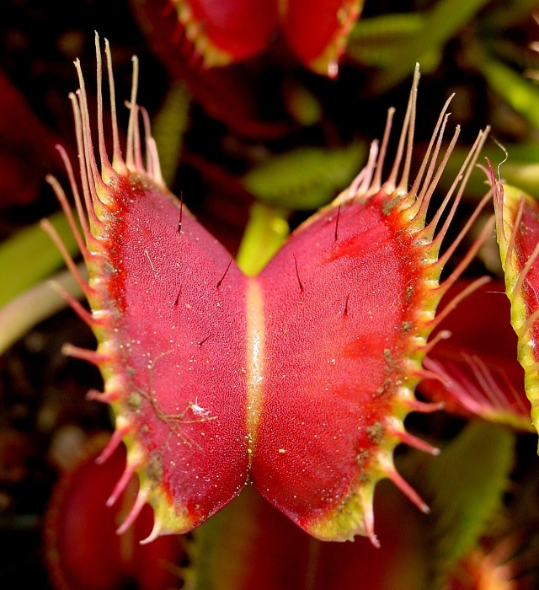
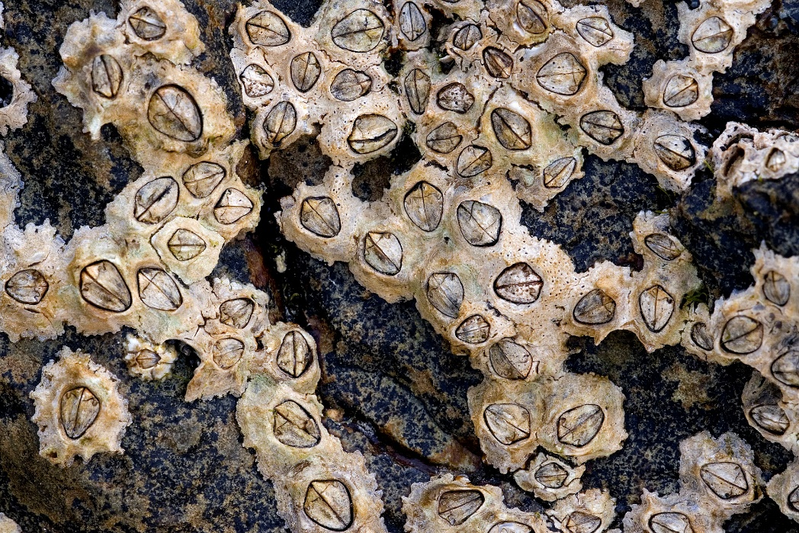
Concept Development
CFU 1
What can Venus flytraps do that most plants cannot?
Characteristics and Classification
It’s usually easy to tell the difference between things like plants and animals, but not always!
To make classification clearer, biologists use a few very specific characteristics to tell the difference between kingdoms.
CFU 2
How are barnacles unlike other animals?
Vocabulary
cha·rac·ter·is·tic (noun) a feature or quality
Notes:
Venus flytraps can move in a way that most plants cannot. Barnacles are sessile (unable to move), but are still classified as animals.

Slide 6
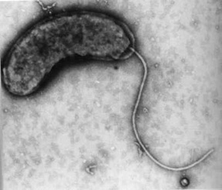
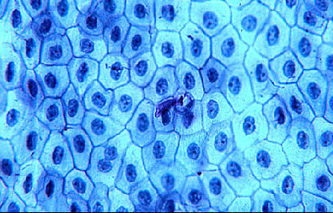
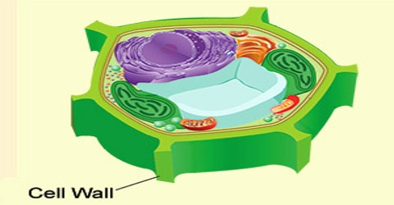
Concept Development
CFU 1
True or false: all living things are made of 10 or more cells.
Cells
All living things are made up of one or more cells (in Latin, cella means ‘small room’).
Some cells are protected by a cell wall, a tough outside layer which provides support and protection.
CFU 2
What does a cell wall provide for its cell?
CFU 3
Do all cells have cell walls?
Vocabulary
cell (noun) The building blocks of living things. All living things are made up of one or more cells. cell wall (noun) the tough outside layer of some cells which protects and supports them
a single-celled organism (bacterium)
a thin section of frog skin

Slide 7
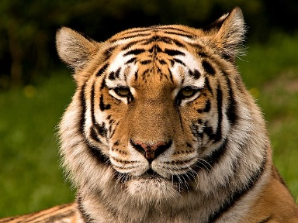
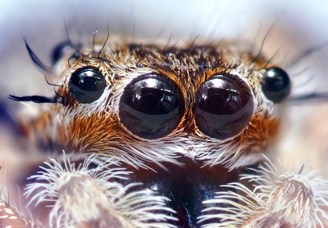
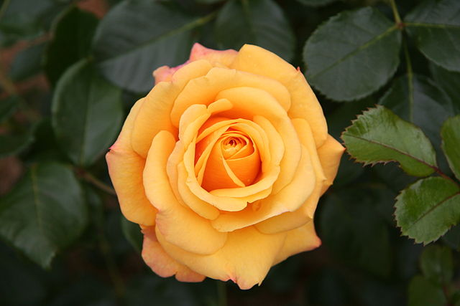
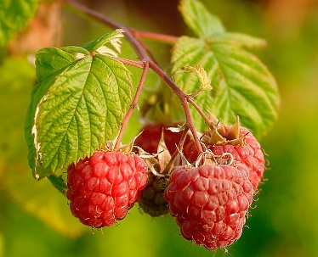
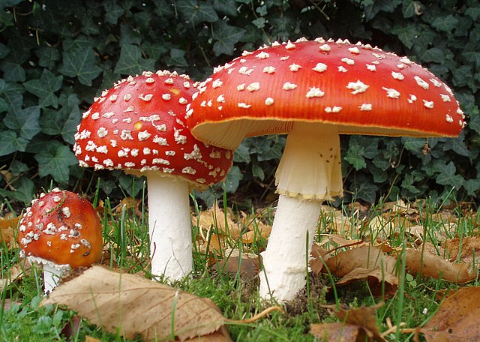
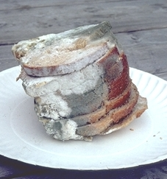
Skill Development
CFU 1
Which kingdom contains producers?
CFU 2
Which kingdom has cells without cell walls?
CFU 3
If an organism is not a producer and does not have cell walls, which kingdom does it belong to?
Kingdoms
Animalia (the animal kingdom). Members of the animal kingdom:
are not producers
do not have cell walls
Plantae (the plant kingdom). Members of the plant kingdom:
are always producers
do have cell walls
Fungi (the fungus kingdom). Members of the fungus kingdom:
are not producers
do have cell walls
CFU 4
If an organism is not a producer and has cell walls, which kingdom does it belong to?
Vocabulary
cell wall (noun) the tough outside layer of some cells which protects and supports them producer (noun) an organism that gets energy from non-living things

Slide 8
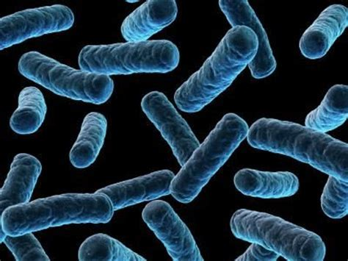
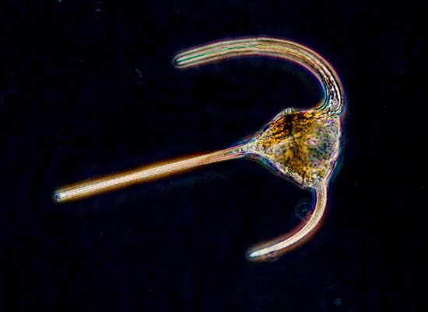
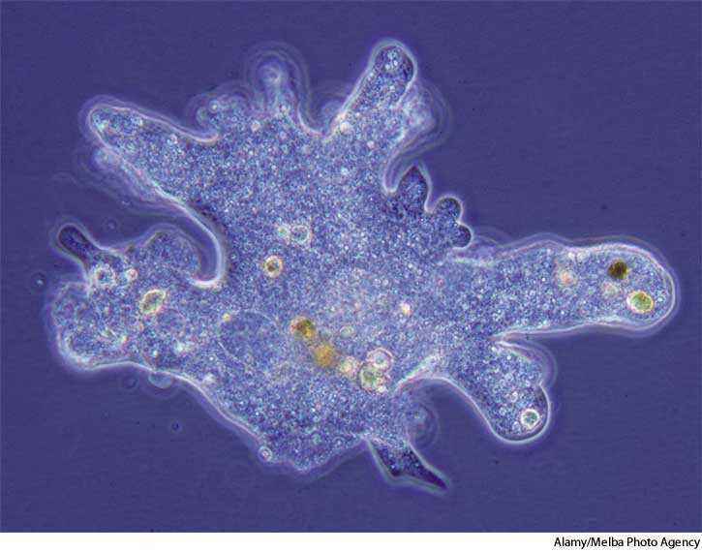
Skill Development
CFU 1
What are the other two kingdoms?
Other Kingdoms
Monera
Unicellular
Cell wall
Mostly bacteria
Protista
More complex cell structures than Monera
Include plankton and amoeba
CFU 2
Give an example of an organism that is in the Monera Kingdom?
CFU 3
Give an example of an organism that is in the Protista Kingdom?

Slide 9
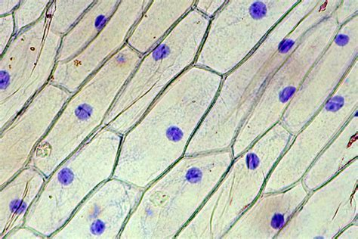
Skill Development/Guided Practice
Identifying Kingdoms
1. Is it a producer? Yes – Plantae 2. If it is not a producer, does its cells have a cell wall? Yes – Fungi No – Animalia
What kingdom does it belong to?
The organism has a cell wall and can make its own food.
Give a reason for your choice.
It is in the Plantae Kingdom because it is a producer with cell walls.
Vocabulary
cell wall (noun) the tough outside layer of some cells which protects and supports them producer (noun) an organism that gets energy from non-living things

Slide 10
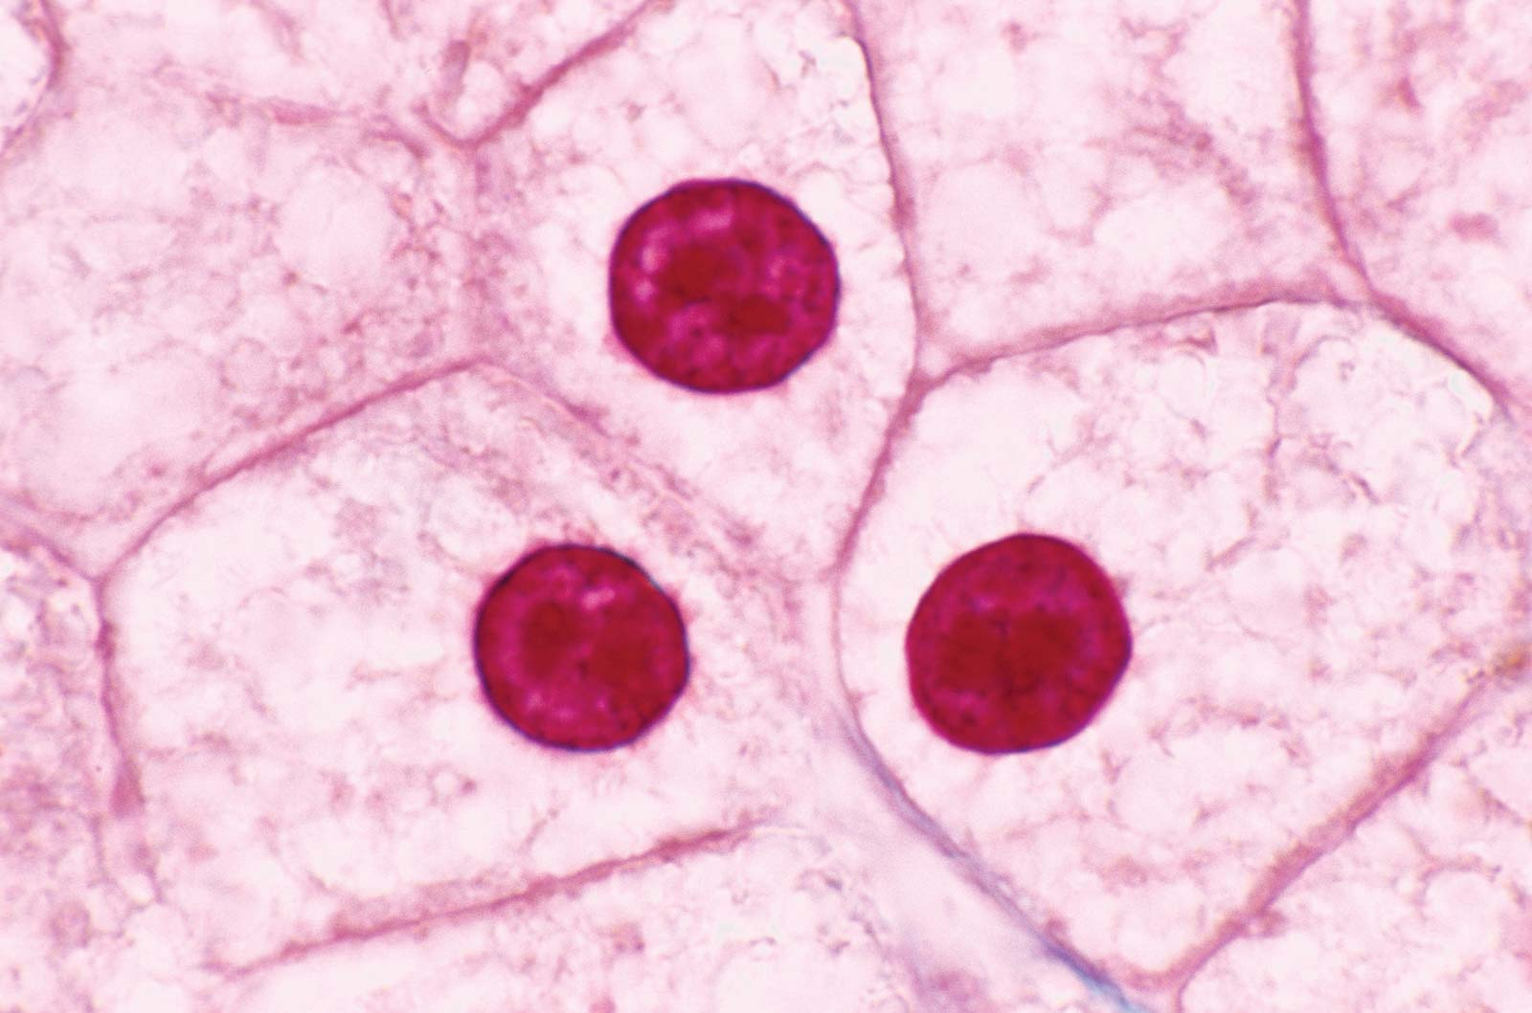
Skill Development/Guided Practice
Identifying Kingdoms
1. Is it a producer? Yes – Plantae 2. If it is not a producer, does its cells have a cell wall? Yes – Fungi No – Animalia
What kingdom does it belong to?
The organism has no cell wall and is a consumer.
Give a reason for your choice.
It is in the Animalia Kingdom because it is not a producer and has no cell walls.
Vocabulary
cell wall (noun) the tough outside layer of some cells which protects and supports them producer (noun) an organism that gets energy from non-living things

Slide 11
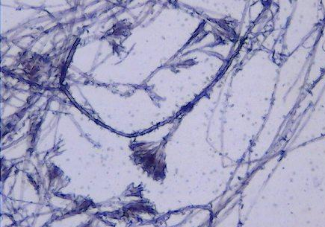
Skill Development/Guided Practice
Identifying Kingdoms
1. Is it a producer? Yes – Plantae 2. If it is not a producer, does its cells have a cell wall? Yes – Fungi No – Animalia
What kingdom does it belong to?
The organism’s cells have cell walls and is not a producer.
Give a reason for your choice.
It is in the Fungi Kingdom because it is not a producer and has cell walls.
Vocabulary
cell wall (noun) the tough outside layer of some cells which protects and supports them producer (noun) an organism that gets energy from non-living things

Slide 12
Relevance
Knowing which kingdom an organism belongs to can quickly tell you a lot about it.
For example, if an organism is classified as Kingdom Animalia (an animal), immediately we already know that it is not a producer and does not have a cell wall.
Placing an organism in a kingdom is the first step in classifying it.

Slide 13
Skill Closure
Reminders:
Animalia Not producers No cell walls Plantae Producers Cell walls Fungi Not producers Cell walls
Which kingdom of living things contains organisms that have cell walls and are not producers?
Skill Closure
Humans are members of the animal kingdom. What does this tell you about your cells?
Skill Closure
The grass outside is a member of the plant kingdom. What does this tell you about its food sources?

Slide 14
Independent Practice
Complete the ‘Understanding Kingdoms’ worksheet.
Reminders:
Animalia Not producers No cell walls Plantae Producers Cell walls Fungi Not producers Cell walls

